Slide 1





Team : Name & Email id
Food Delivery System (Like Zomato)
Name : Pranishraj Nigade
Email : pranishrajnigade45@gmail.com
Disclaimer: The content is curated for educational purposes only.
Notes:
Slides: Prepare a short slide deck (10-12 slides) summarizing the project objectives, methodology, and key results.

Slide 2
OUTLINE
• Problem Statement
• Proposed Solution
• Two Screenshots of the Project
• GitHub link

Slide 3
Problem Statement
Problem Statement-The traditional method of ordering food over the phone is time-consuming, prone to errors, and lacks real-time tracking. Customers often face challenges such as:
•Limited restaurant options in a single platform.
•Manual order processing, leading to miscommunication.
•Lack of transparency in delivery tracking and estimated time.
•Inefficient payment system with no online payment tracking.
•No centralized review system for restaurants and dishes
Design schema
Insert records
Test project

Slide 4
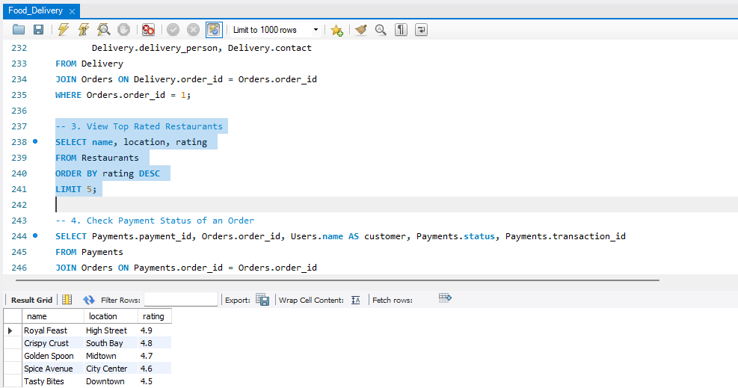
Screenshot of Project

Slide 5
GitHub Link
-Food-Delivery-System-Like-Zomato-

Slide 6
Thank you!
Notes:
thank you very much for joining this PPT, keep learning.
6

